Slide 1

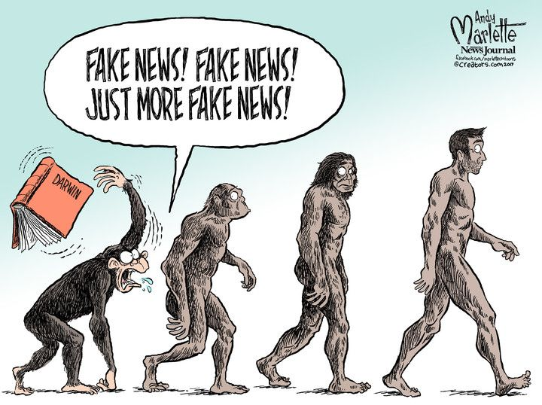
Fake News Detection Project (Using ML (NLP))
Submitted by:
ARUN KUMAR M

Slide 2

Introduction 1. What is Fake News Detection? 2. Importance of Fake News Detection. 3. Business Problem – Fake News influencing social and political environments. Analytics of the Business Problem 1. What is Analytical problem framing? 2. Analytics of the business problem. 3. Hardware Requirements. 4. Software Requirements. 5. Tools, Libraries and Packages used. 6. Data sources. 7. Pre-Assumptions. 8. Data Pre-Processing. ML Model Development and Evaluation 1. Problem Identification. 2. Listing of ML Models. 3. Processing the Data-set for Training and Testing. 4. Evaluation of ML Models. 5. Hyper Tuning of the ML Model. 6. Final Results. Conclusion

Slide 3
What is Fake News Detection?
Against the changes the world is currently facing, an increasing number of daily tasks are moving online, including reading the news and being informed about relevant topics. The increase in the volume of information made available led, in turn, to fake news dissemination becoming a trending topic on the Internet. Recent events such as the pandemic have shown that “Fake news exerts a significant negative influence on societies by highlighting stories that do not necessarily report on facts”. Research communities expressed concern about this flood of misinformation and introduced automated fake news identification solutions based on Natural Language Processing (NLP) techniques. In this study, we reference existing datasets and related work in the analysis of English fake news, discuss potential detection techniques for Fake news, as well as establish future work plans for this research initiative.

Slide 4
Importance of Fake News Detection.
News media has become a channel to pass on the information of what’s happening in the world to the people living. Often people perceive whatever conveyed in the news to be true. There were circumstances where even the news channels acknowledged that their news is not true as they wrote. But some news has a significant impact not only on the people or government but also on the economy. One news can shift the curves up and down depending on the emotions of people and political situation.
“Fake news serves to misinform people and manipulate their opinions for several reasons”.
It is important to identify the fake news from the real true news. The problem has been taken over and resolved with the help of Natural Language Processing tools which help us identify fake or true news based on historical data.

Slide 5
Business Problem – Fake News influencing social and political
environments.
The authenticity of Information has become a longstanding issue affecting businesses and society, both for printed and digital media. On social networks, the reach and effects of information spread occur at such a fast pace and so amplified that distorted, inaccurate, or false information acquires a tremendous potential to cause real-world impacts, within minutes, for millions of users. Recently, several public concerns about this problem and some approaches to mitigate the problem were expressed. The sensationalism of not-so-accurate eye-catching and intriguing headlines aimed at retaining the attention of audiences to sell information has persisted all throughout the history of all kinds of information broadcast.

Slide 6
Hardware Requirements
A mid level computer that runs on Intel i3/i5/i7 or A10/A11/M1 or ryzen 3/5 or any other equivalent chipset and a suitable processor.
Software Requirements
Windows / Linux /Mac OS

Slide 7
Tools, Libraries and Packages used
Tool: 1.Anaconda Navigator
2. Jupyter Notebook
Libraries and Packages:
1. Numpy
2. Pandas
3. Matplotlib
4. Seaborn
5. NLTK and its derivatives
6. Regex expressions
7. String
8. Classification ML models.

Slide 8
Data sources
There are 6 columns in the dataset provided to you.
The description of each of the column is given below:
“Id”: Unique id of each news article
“Headline”: It is the title of the news.
“News”: It contains the full text of the news article
“Unnamed: 0”: It is a serial number
“Written by”: It represents the author of the news article
“Label”: It tells whether the news is fake (1) or not fake (0).
The shape of the data set is 20800 x 6, that is data set consist of 20800 rows and 6
columns.

Slide 9
Pre-Assumptions
As we look into the data –set, primarily we could infer that the data-set is
Pretty much well informed.
1. It has all the required data’s such
# Column Non-Null Count Dtype
--- ------ -------------- -----
0 Unnamed: 0 20800 non-null int64
1 id 20800 non-null int64
2 headline 20242 non-null object
3 written by 18843 non-null object
4 news 20761 non-null object
5 label 20800 non-null int64
2. The numbers of entries in the Label column is divided into 2, fake (1) and Not Fake (0). It is distributed as represented as below:
#values and count of the target variable,
1 – 10413 (Fake News)
0 – 10387 (Not a Fake News)

Slide 10
Data Pre- Processing
Here we will try to make the given data-set efficient for the ML model. For that we will carry out a series of process which will make the data-set perfect for building a ML model. This series of process includes,
Collection of basic statistical data.
Exploratory data analysis.
Text Data Pre-Processing.
Text Data Vectorization.
By following these processes we can achieve a more efficient data-set. We will use Python through Jupyter notebook for data processing. Also we will use Libraries such as Pandas, Numpy for Analysis and Matplotlib, seaborn for visualization.

Slide 11
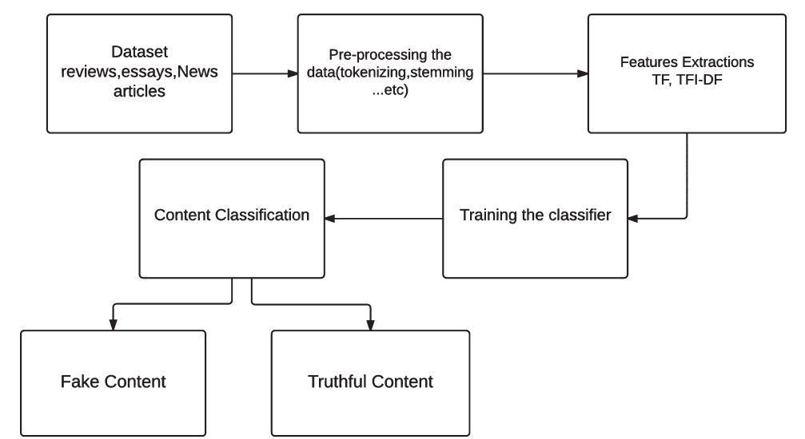

Slide 12


Slide 13
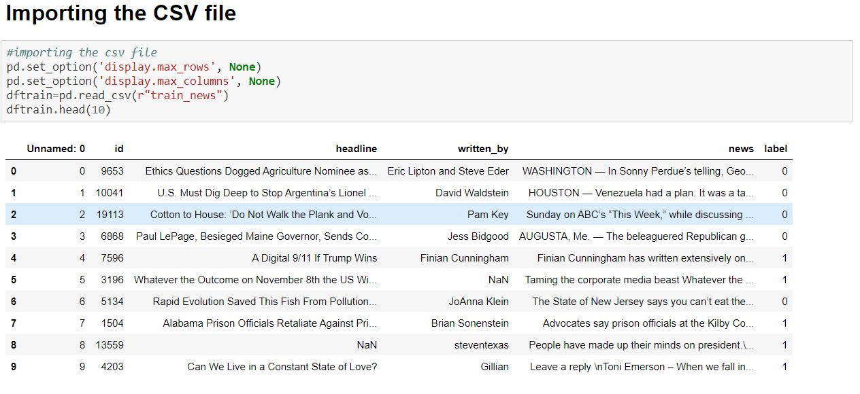

Slide 14
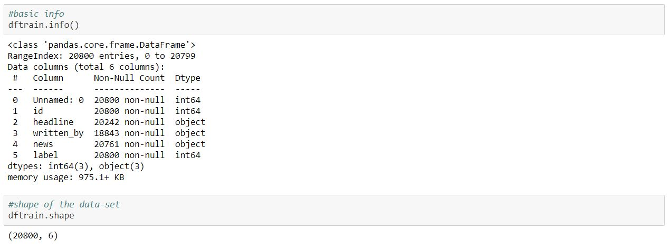

Slide 15
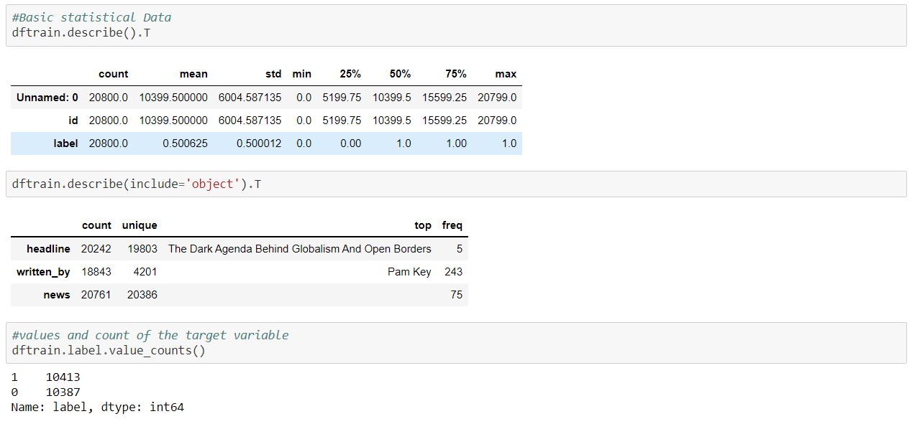

Slide 16
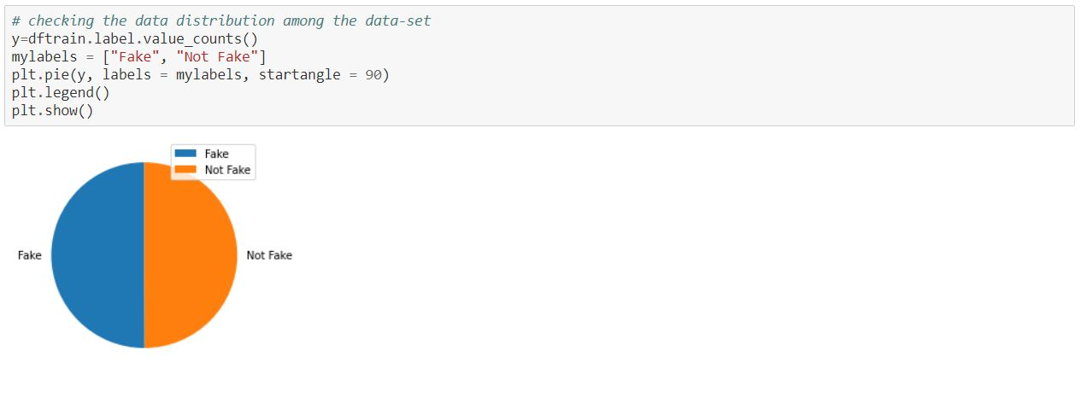

Slide 17
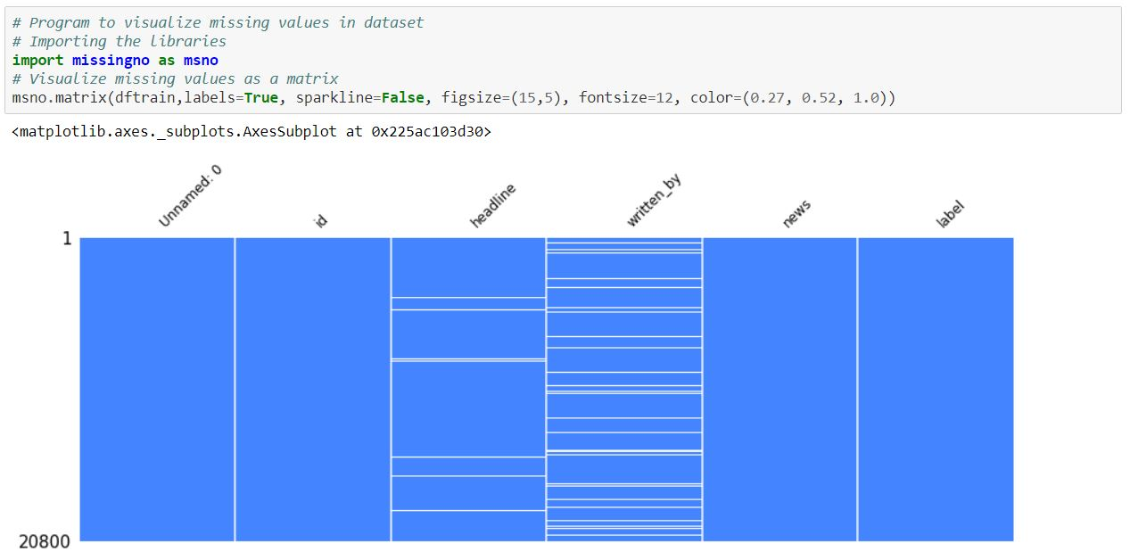

Slide 18
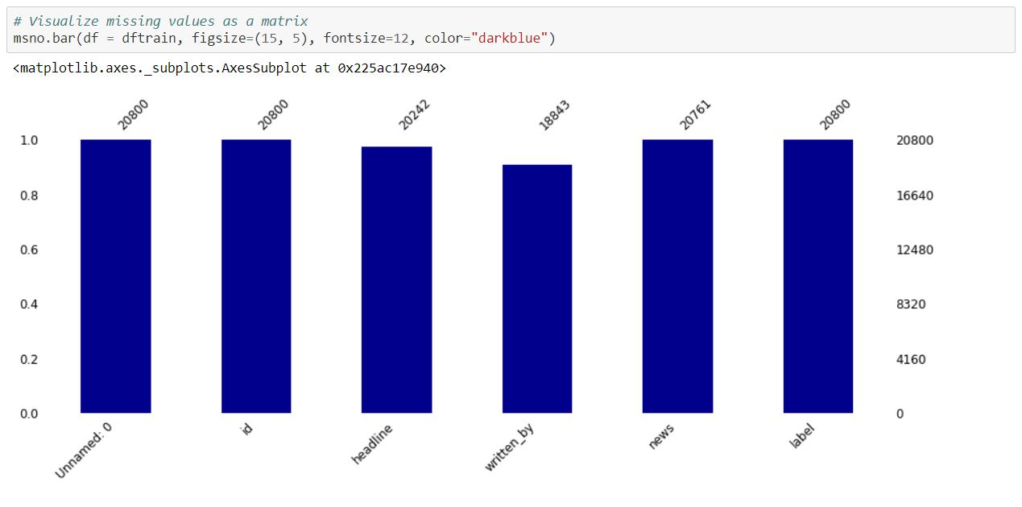

Slide 19
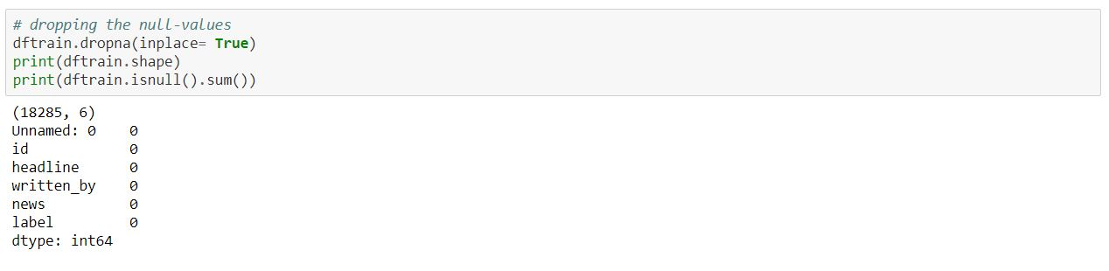

Slide 20
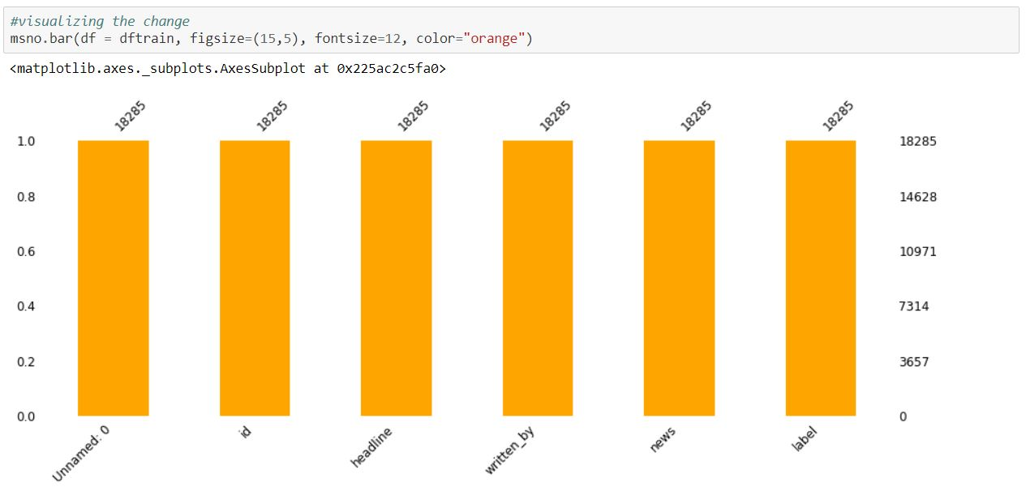

Slide 21
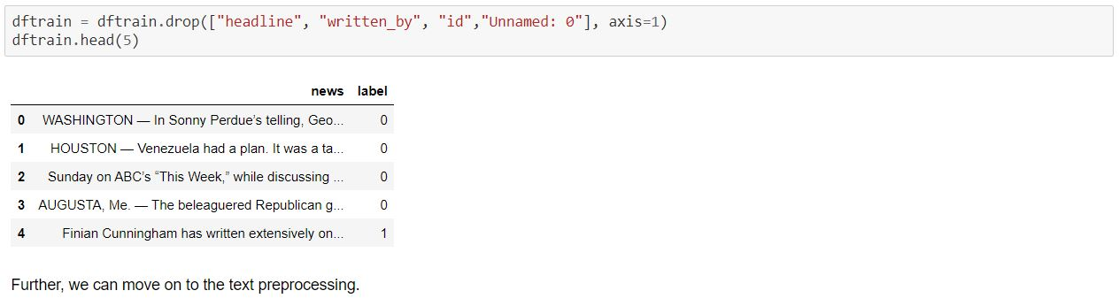

Slide 22
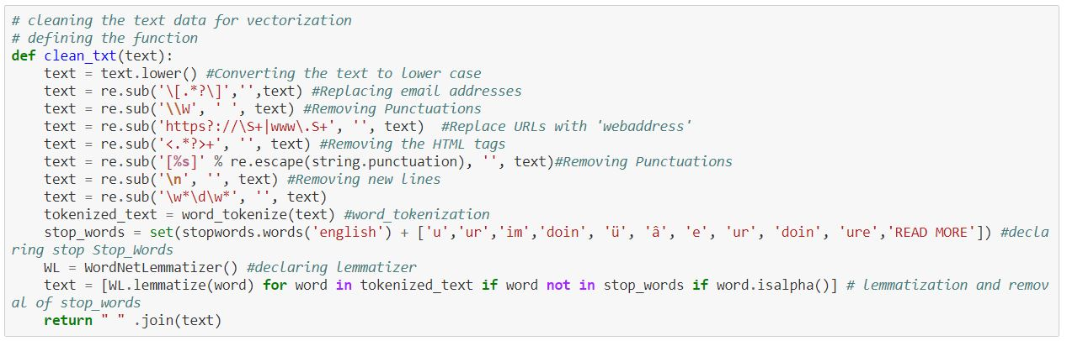

Slide 23
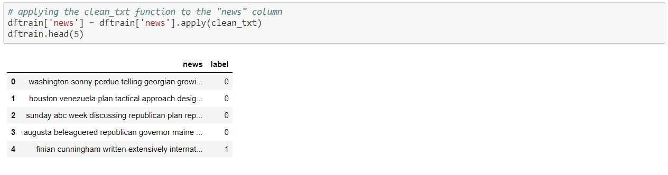

Slide 24
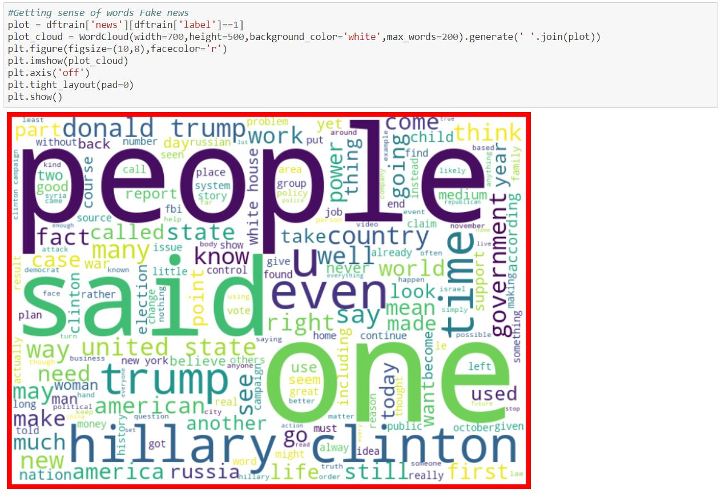

Slide 25
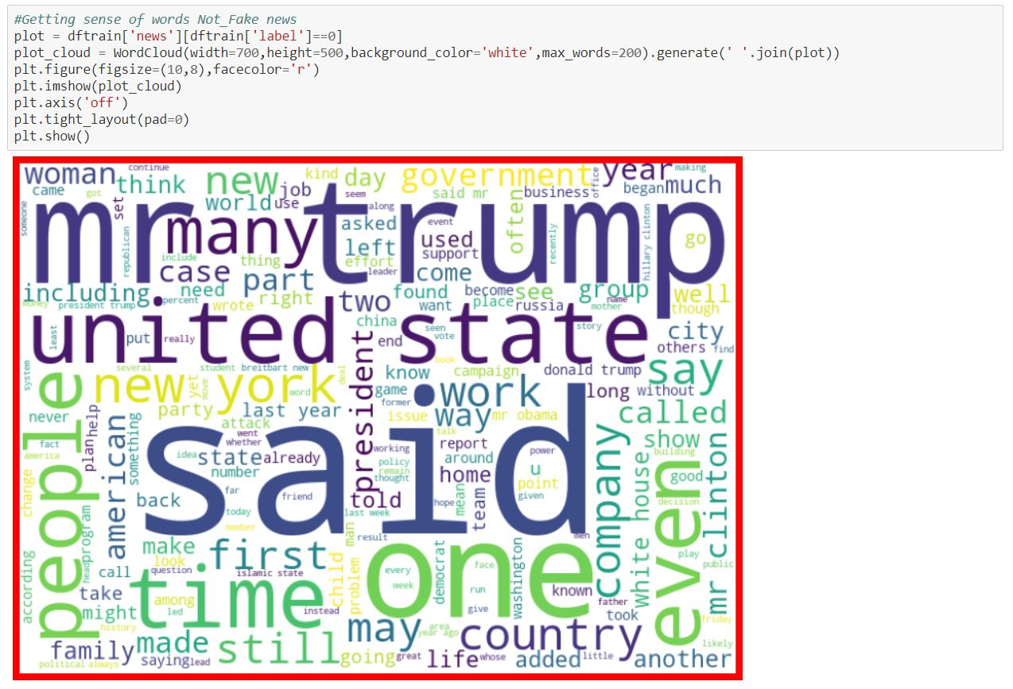

Slide 27
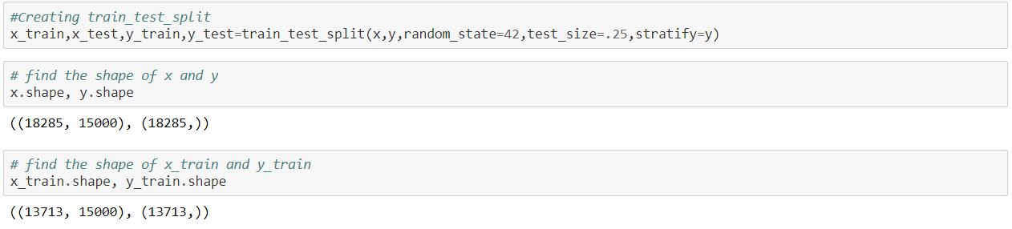

Slide 28
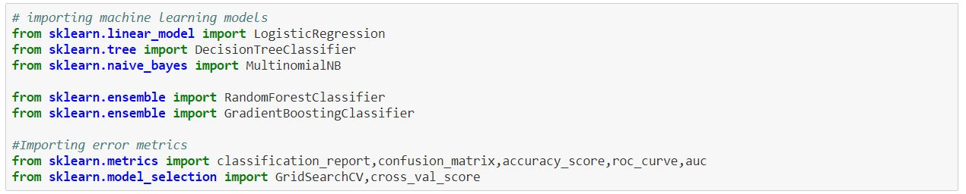

Slide 29
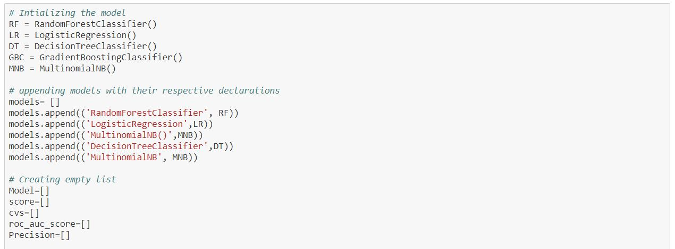

Slide 30
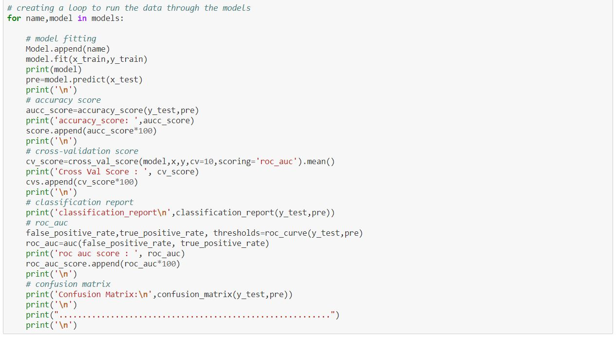

Slide 31
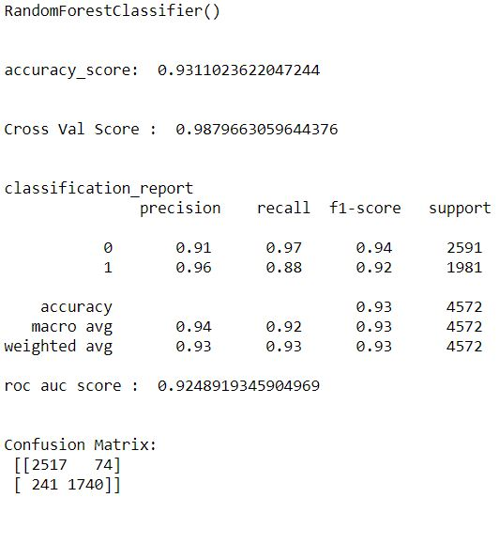

Slide 32
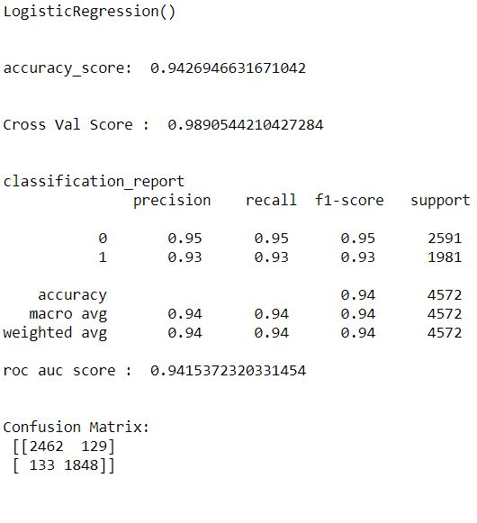

Slide 33
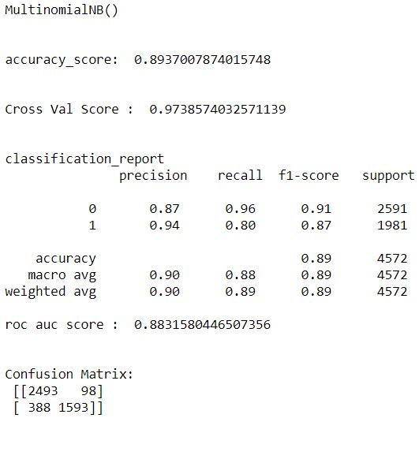

Slide 34
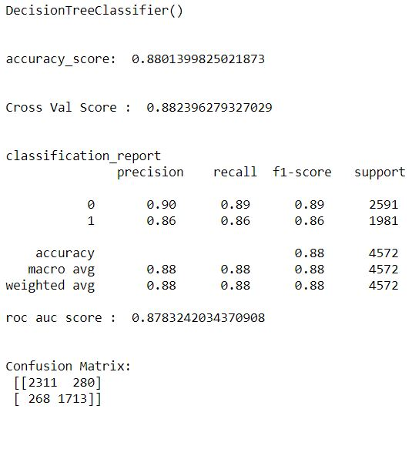

Slide 35
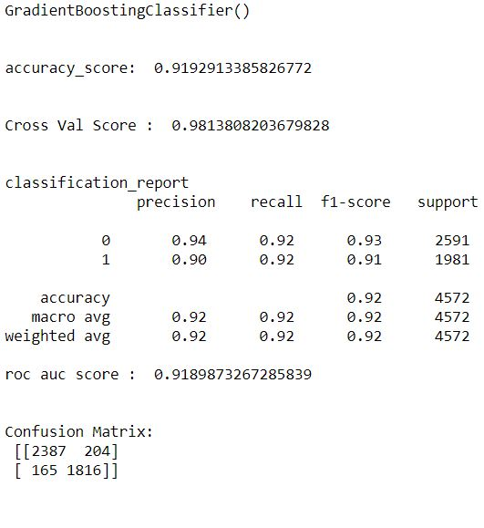

Slide 36
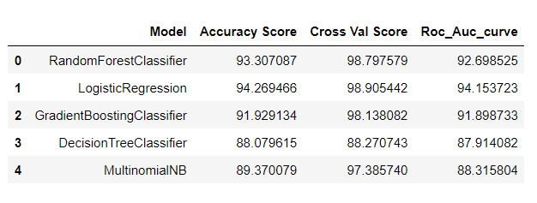

Slide 37
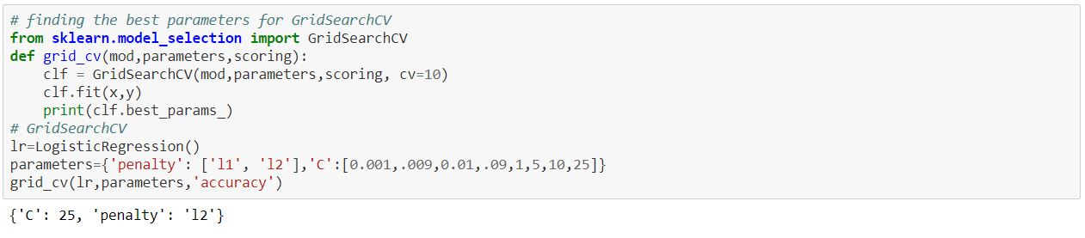

Slide 38
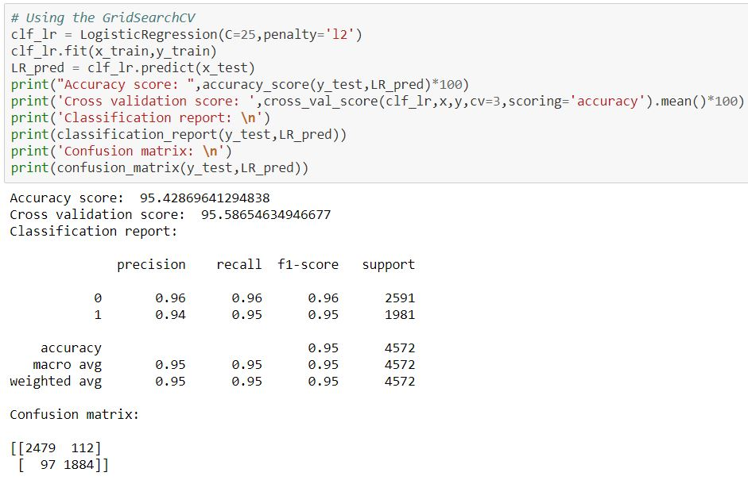

Slide 39
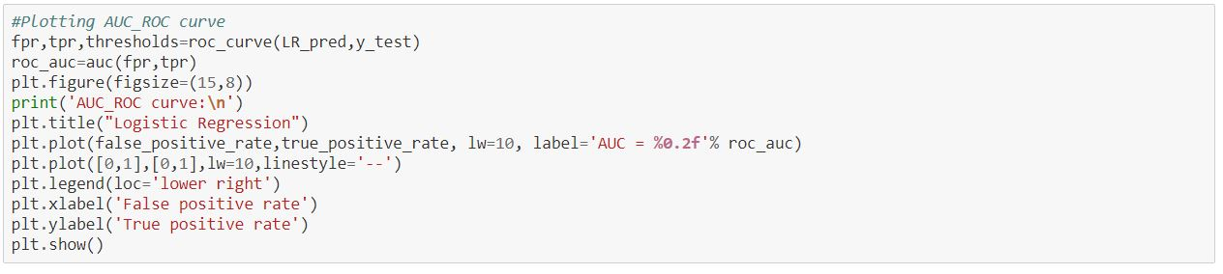

Slide 40
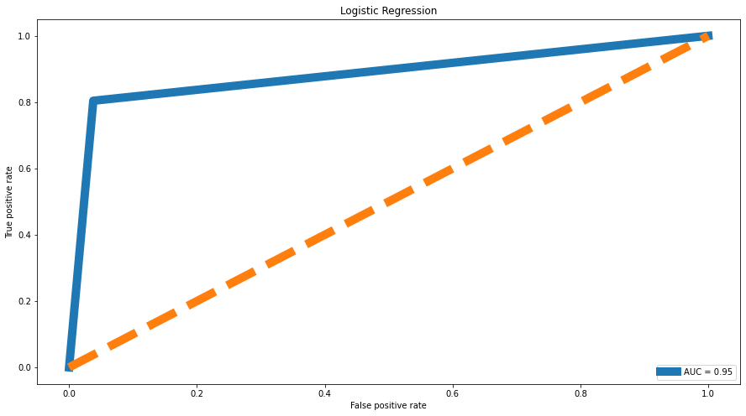

Slide 41
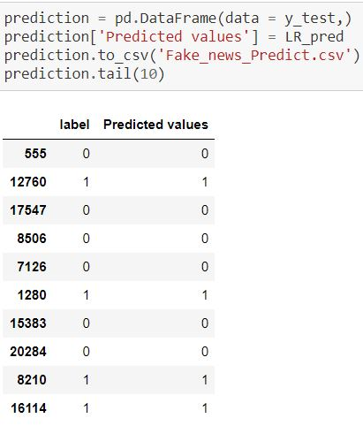

Slide 42
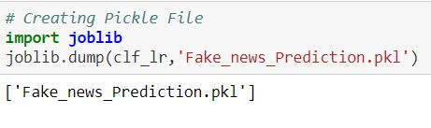

Slide 43
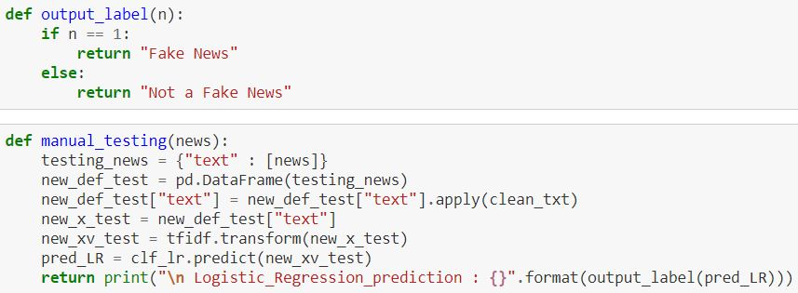

Slide 44
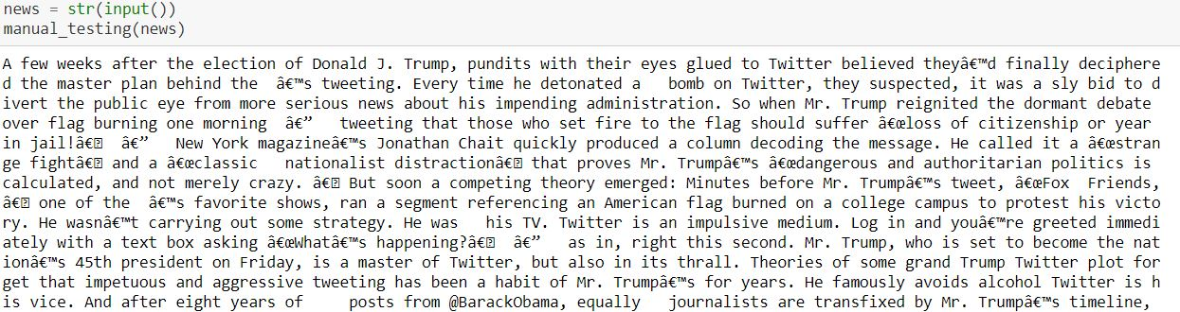

Slide 46
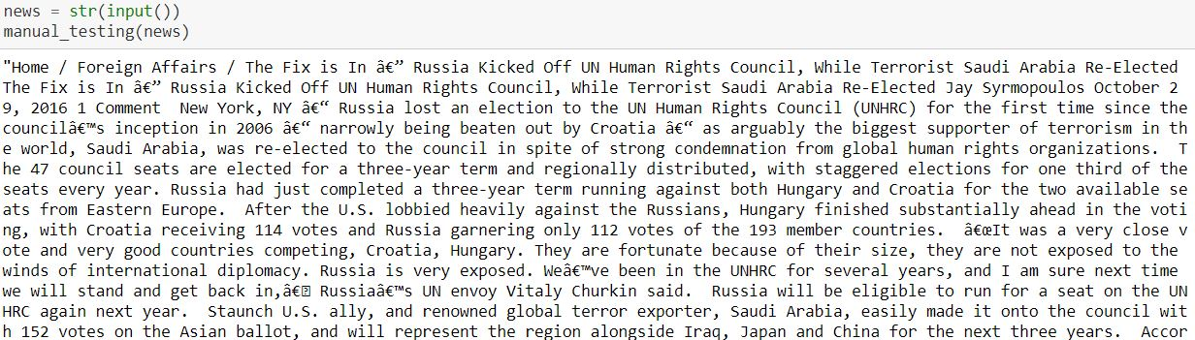

Slide 47


Slide 48
CONCLUSION:
The "Logistic Regression" works well with the given dataset.
The manual testing gives a very positive result.

Slide 49
Limitations:
Lack of more information leads to minimized usage of the ML models potential.
More feature engineering is need for the data-set.
With the help of more supporting information the model can be used efficiently for all news sectors.

Slide 50

Fin.

